Slide 1


Pointers
Nazrin Dolkhanova Sultanli
Programming and Computer Applications – 1

Slide 2



Agenda
What is pointer
Pointer arithmetic
Pointers & Arrays
Passing pointers to functions
Pointer to functions
Multidimensional array pointer
Pointer to Pointer

Slide 3

Topic five
Pointers

Slide 4
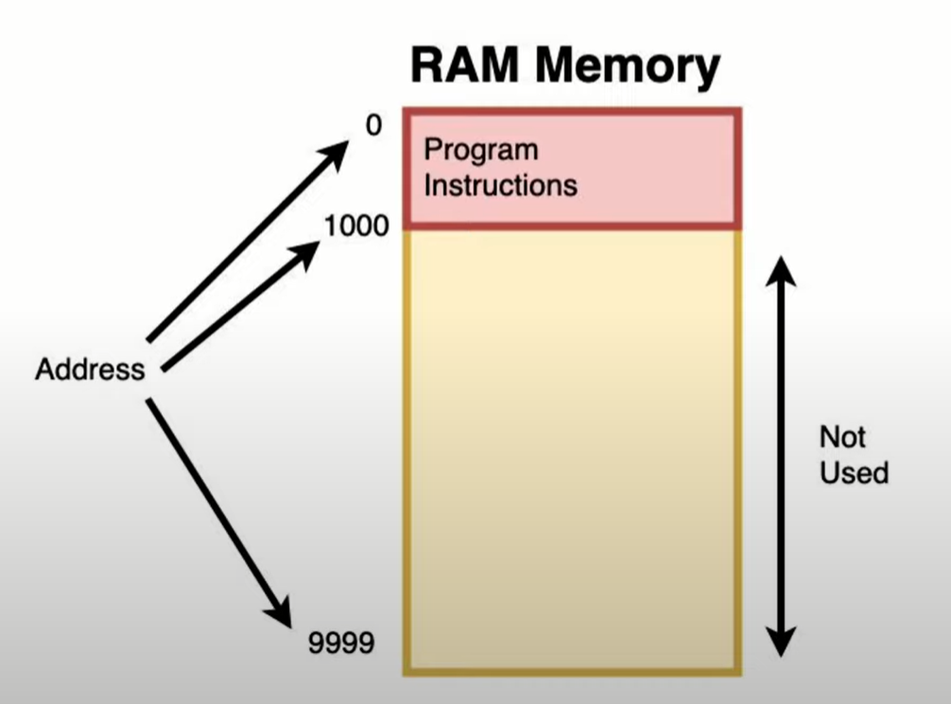
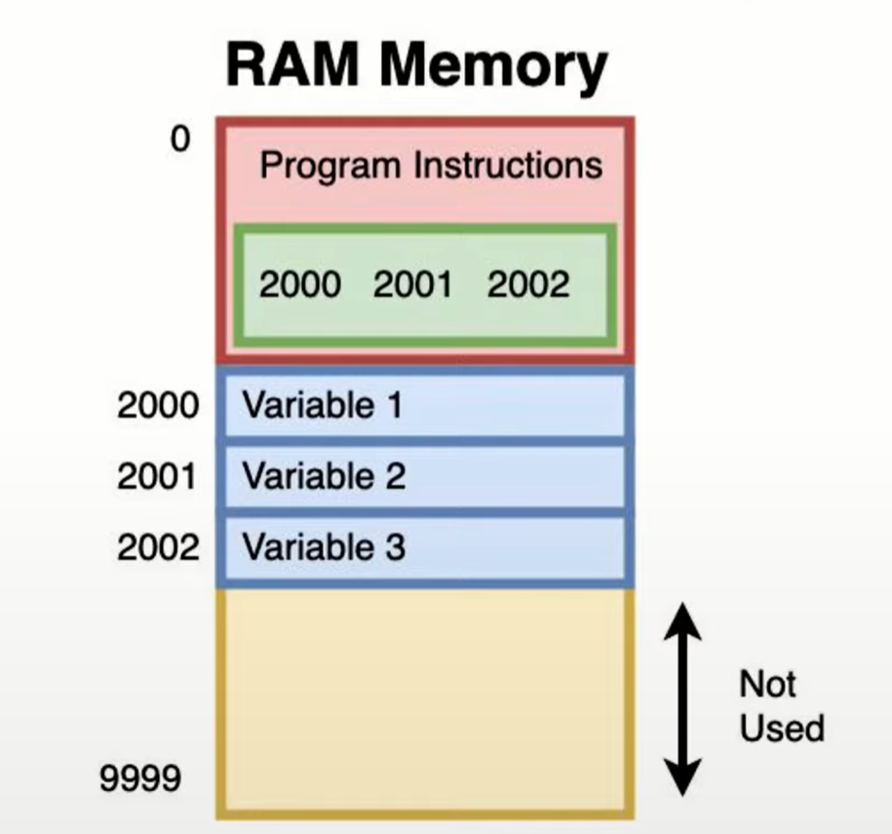
5.1 What is pointer
Programs and data (i.e. variables) are both stored in a computer’s RAM.
When Program creates variables, they stored in memory at a memory address.
Memory addresses are a positive integer that uniquely identifies a position in memory. It is at this positions that a variables data is stored (i.e a number).

Slide 5
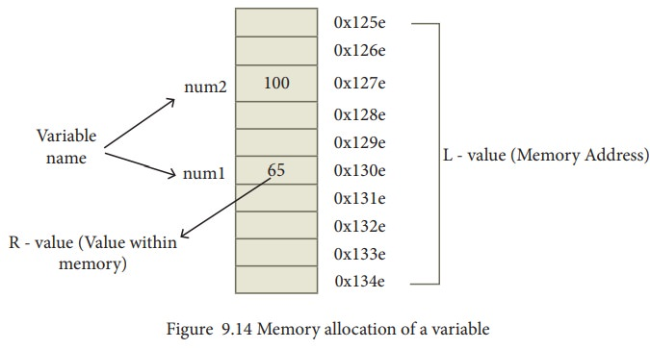
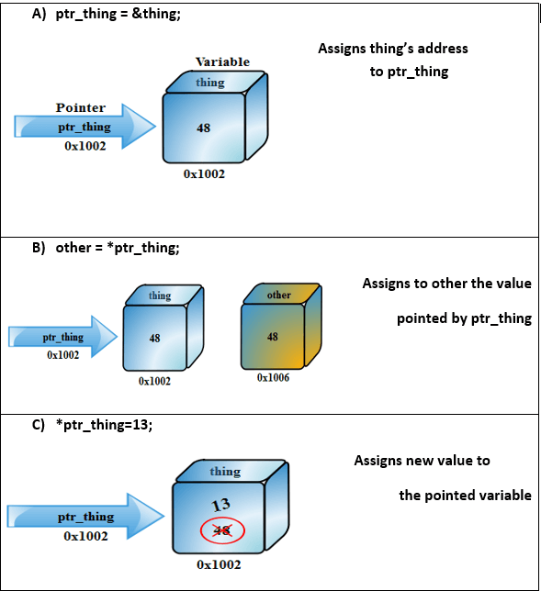
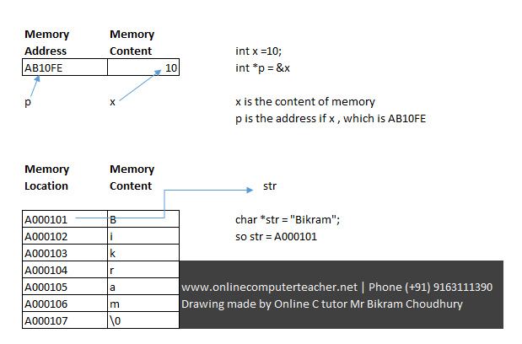
5.1 What is pointer

Slide 6
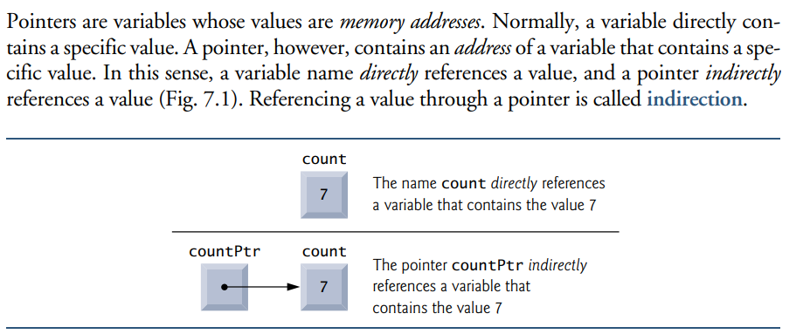
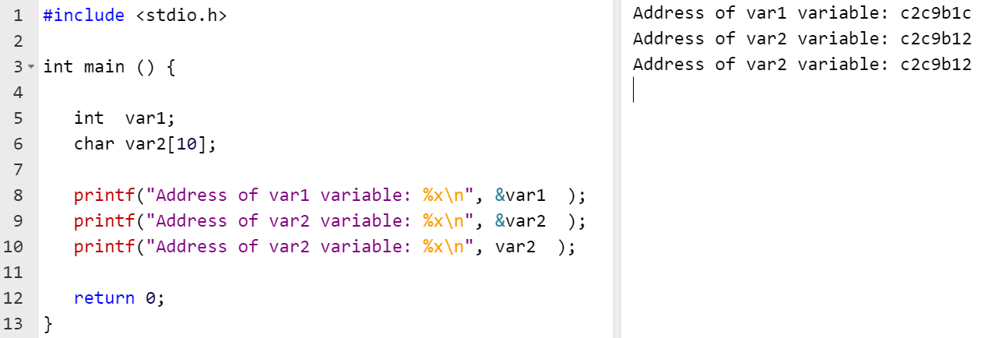
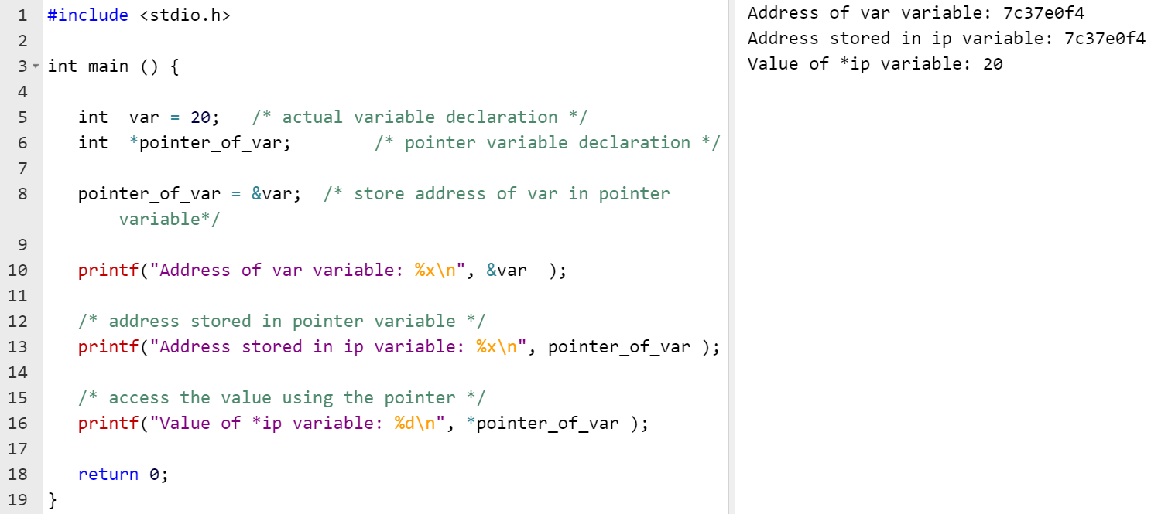
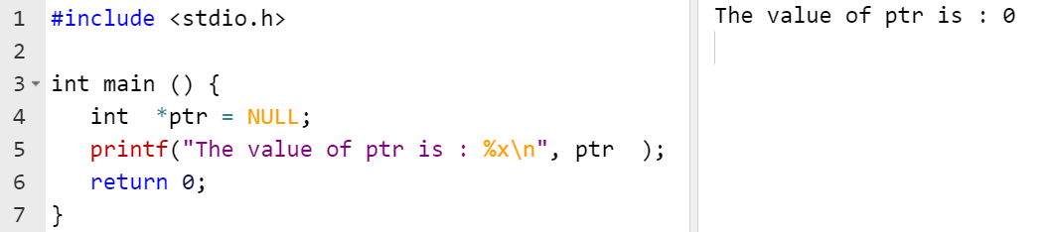
5.1 What is pointer
Pointers are variables whose values are memory addresses. Normally, a variable directly contains a specific value. A pointer, however, contains an address of a variable that contains a specific value. In this sense, a variable name directly references a value, and a pointer indirectly
references a value. Referencing a value through a pointer is called indirection.
Recall that when you declare a variable, a contiguous block of bytes is reserved in memory. A pointer to a variable is the address of the first of these bytes. . A pointer can be created for every type of variable: be it primitive (for example int, char, or double), a custom data type created using a struct, or even another pointer.
dataType* nameOfPointer;
or
dataType *nameOfPointer;
int *ip; /* pointer to an integer; ip stores the address of the first byte of a block of memory containing an int
int x; // Create an int variable int* ptr ptr = &x; // Pointer to that int- reference operator (&)– memory address of x //int* ptr = &x; // Pointer to that int- version 2 printf("%p", ptr); // %p needed to instruct printf() that ptr is of type pointer
The data contained in the memory address pointed to by a pointer can be accessed using the dereference operator (*). The syntax is as follows:
*pointerName;
int x = 4; int* ptr = &x; // ptr stores the memory address of variable x int y = *ptr; // Declare variable y and assign to it the data stored in memory pointed to by ptr, which is the value of variable x printf("%i", y);
Assign a NULL value to a pointer variable in case you do not have an exact address to be assigned.
Notes:
#include <stdio.h>int main () { int var1; char var2[10]; printf("Address of var1 variable: %x\n", &var1 ); printf("Address of var2 variable: %x\n", &var2 ); printf("Address of var2 variable: %x\n", var2 ); return 0;}
#include <stdio.h>int main () { int var = 20; /* actual variable declaration */ int *pointer_of_var; /* pointer variable declaration */ pointer_of_var = &var; /* store address of var in pointer variable*/ printf("Address of var variable: %x\n", &var ); /* address stored in pointer variable */ printf("Address stored in ip variable: %x\n", pointer_of_var ); /* access the value using the pointer */ printf("Value of *ip variable: %d\n", *pointer_of_var ); return 0;}

Slide 7
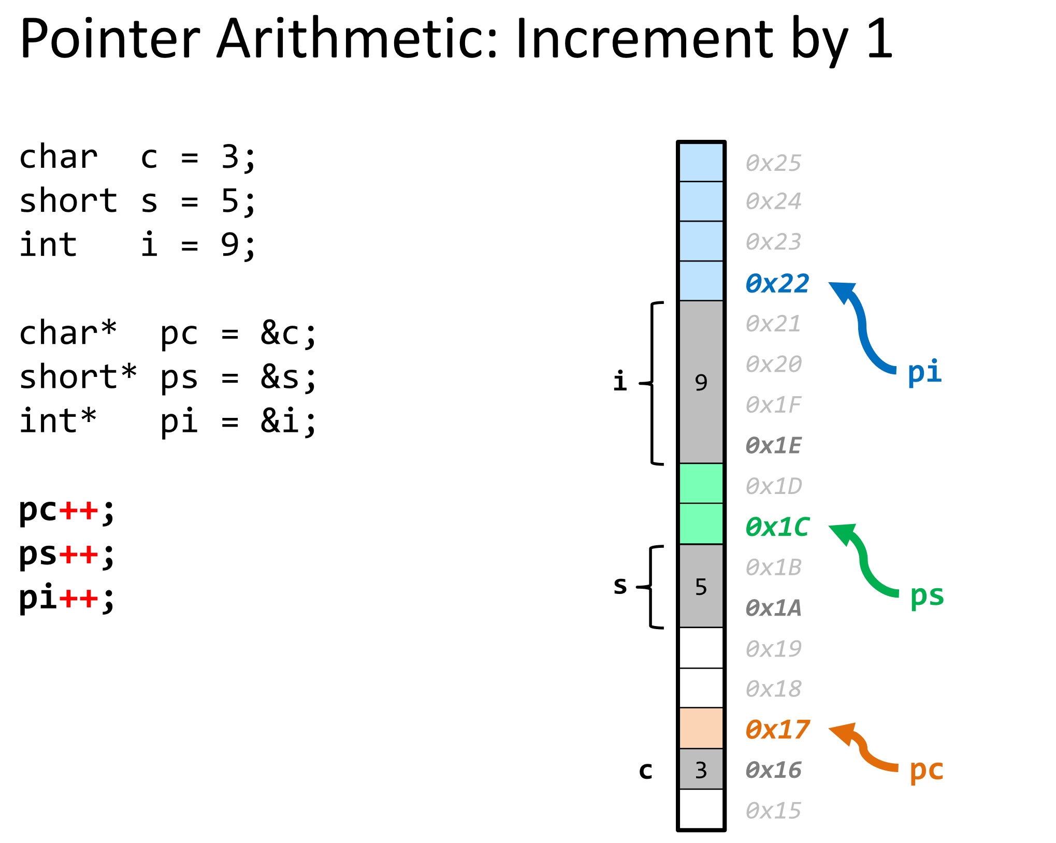
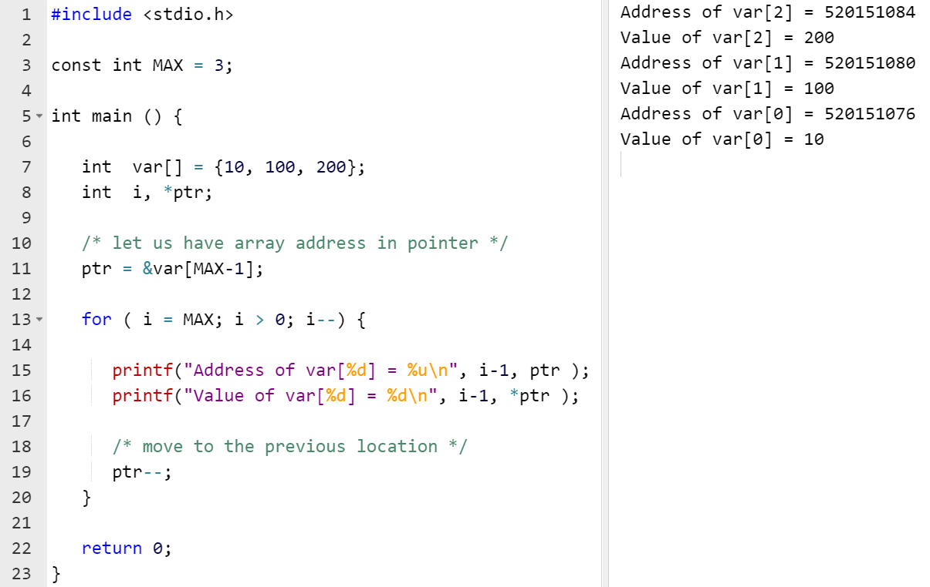
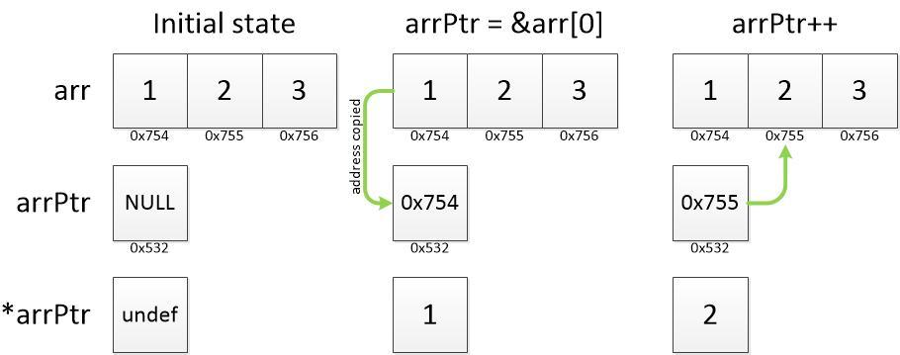
5. 2 Pointer arithmetic
Pointer is a special type of integer variable. So, basic arithmetic operations can be done on pointers.
The only arithmetic operations allowed for pointers are addition and subtraction. Conceptually, adding to (or subtracting from) a pointer means the pointer will point to some new address. Multiplication is not allowed because the address of a byte of memory is usually a large number; therefore, multiplying an address may yield an even larger number, possibly representing an address outside the bounds of the available memory space. Division is not allowed as it potentially allows a pointer to illogically point to an address with a non-integer index.
The addition operation for a pointer is only valid when adding an integer to a pointer; you cannot add two or more pointers together!
pointer = pointer + n; pointer += n; // Same outcome with different syntax
The important thing to note here is that adding n to a pointer does not increment the address to point to a value n bytes away. It moves the pointer by n * (size of the data type in bytes). For example, if a pointer to an int, the size of which is four bytes, initially contains address 100 (we will use a decimal address for simplicity), and three is added to the pointer, the pointer will now point to address 112.
Notes:
#include <stdio.h> const int MAX = 3; int main () { int var[] = {10, 100, 200}; int i, *ptr; /* let us have array address in pointer */ ptr = &var[MAX-1]; for ( i = MAX; i > 0; i--) { printf("Address of var[%d] = %x\n", i-1, ptr ); printf("Value of var[%d] = %d\n", i-1, *ptr ); /* move to the previous location */ ptr--; } return 0; }

Slide 8
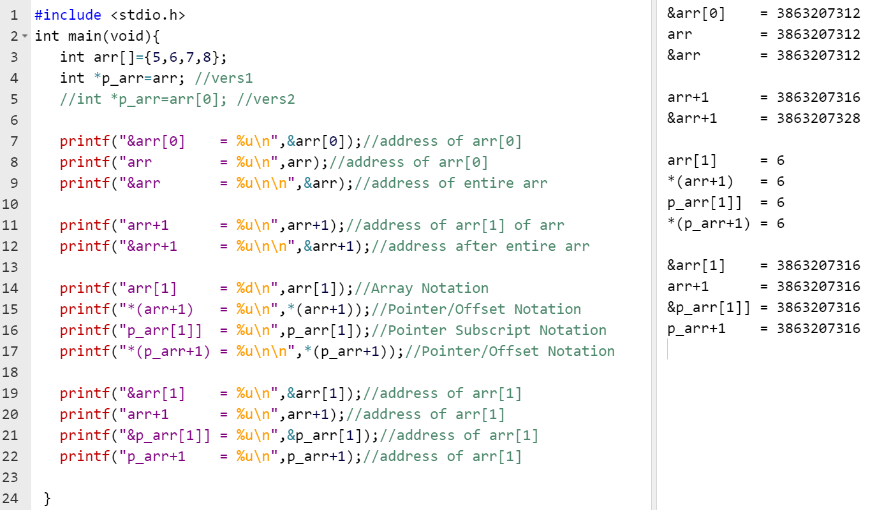
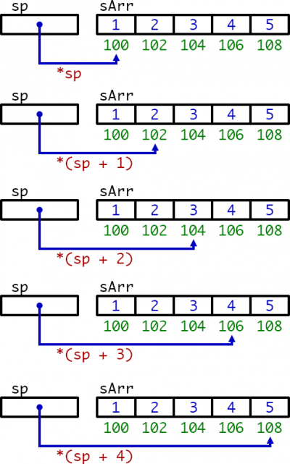
5. 2 Pointer arithmetic
int arr[10] = {2, 4, 7, 1, 10, 3, 11, 6, 20, 5}; printf("%zu", arr); // pointer to first element of array printf("%zu", &arr); // pointer to entire array
Notes:
#include <stdio.h>
int main(void){
int arr[]={5,6,7,8};
int *p_arr=arr; //vers1
//int *p_arr=arr[0]; //vers2
printf("&arr[0] = %u\n",&arr[0]);//address of arr[0]
printf("arr = %u\n",arr);//address of arr[0]
printf("&arr = %u\n\n",&arr);//address of entire arr
printf("arr+1 = %u\n",arr+1);//address of arr[1] of arr
printf("&arr+1 = %u\n\n",&arr+1);//address after entire arr
printf("arr[1] = %d\n",arr[1]);//Array Notation
printf("*(arr+1) = %u\n",*(arr+1));//Pointer/Offset Notation
printf("p_arr[1]] = %u\n",p_arr[1]);//Pointer Subscript Notation
printf("*(p_arr+1) = %u\n\n",*(p_arr+1));//Pointer/Offset Notation
printf("&arr[1] = %u\n",&arr[1]);//address of arr[1]
printf("arr+1 = %u\n",arr+1);//address of arr[1]
printf("&p_arr[1]] = %u\n",&p_arr[1]);//address of arr[1]
printf("p_arr+1 = %u\n",p_arr+1);//address of arr[1]
}

Slide 9
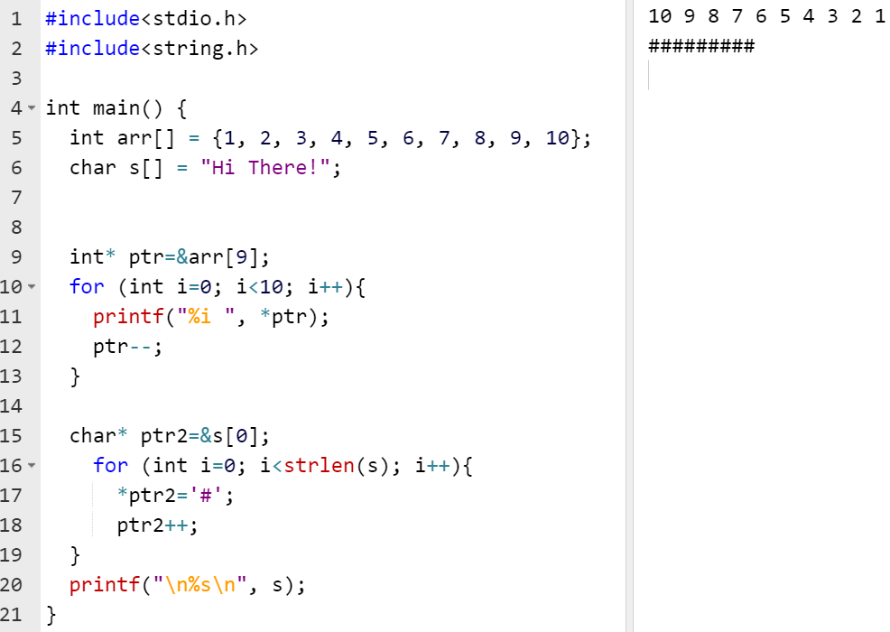
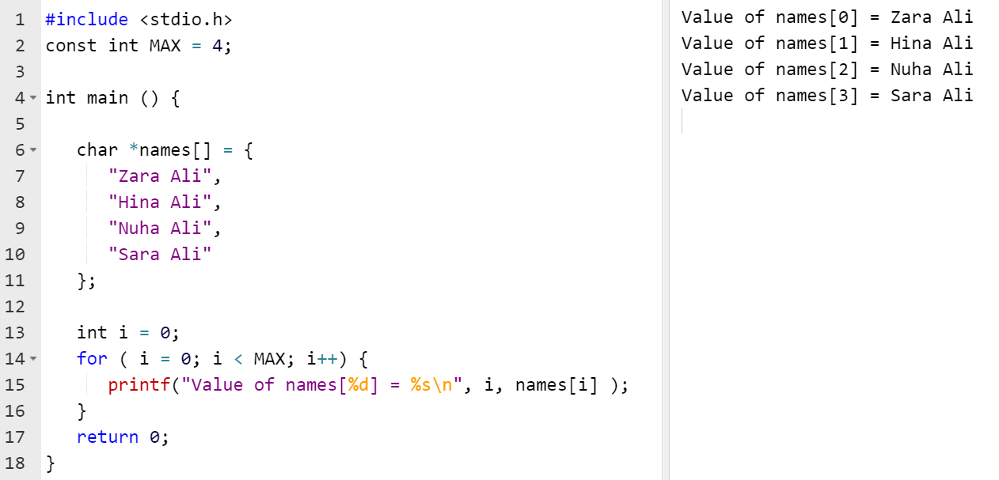
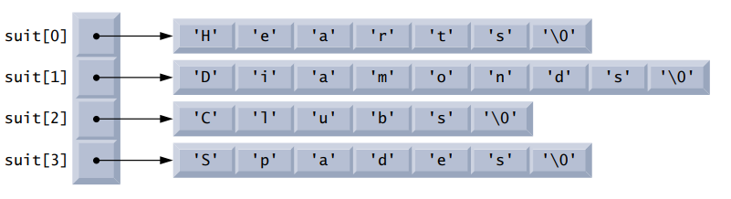
5.3 Pointers & Arrays
Since arrays are contiguous blocks of memory, if we have a pointer to the first element, we can use pointer arithmetic to access the rest of the array.
int arr[10] = {2, 4, 7, 1, 10, 3, 11, 6, 20, 5}; int* ptr = &arr[0]; // Pointer to the first element for(int i = 0; i < 10; i++){ printf("%i\n", *ptr); // Dereference the pointer and print the value ptr++; // Increment the pointer to point to the next int in the array }
Change the values of an array using pointers by changing all the elements in an array to three:
int arr[10] = {2, 4, 7, 1, 10, 3, 11, 6, 20, 5}; int* ptr = &arr[0]; // Pointer to the first element for(int i = 0; i < 10; i++){ *ptr = 3; // Dereference the pointer and assign the value at the ptr address to three ptr++; // Increment the pointer to point to the next int in the array }
Arrays of pointer (string array):
const char *suit[4] = {"Hearts", "Diamonds", "Clubs", "Spades"};
Notes:
#include<stdio.h>
#include<string.h>
int main() {
int arr[] = {1, 2, 3, 4, 5, 6, 7, 8, 9, 10};
char s[] = "Farmer Jack realized that big yellow quilts were expensive!!";
int* ptr=&arr[9];
for (int i=0; i<10; i++){
printf("%i ", *ptr);
ptr--;
}
char* ptr2=&s[0];
for (int i=0; i<strlen(s); i++){
*ptr2='#';
ptr2++;
}
printf("%s\n", s);
}
#include <stdio.h>const int MAX = 4; int main () { char *names[] = { "Zara Ali", "Hina Ali", "Nuha Ali", "Sara Ali" }; int i = 0; for ( i = 0; i < MAX; i++) { printf("Value of names[%d] = %s\n", i, names[i] ); } return 0;}

Slide 10
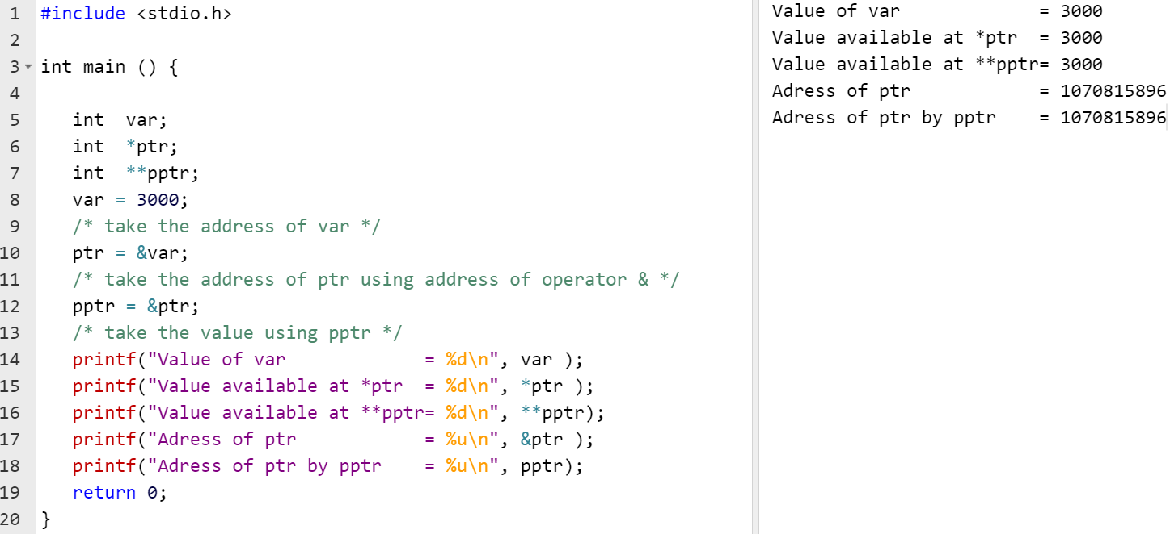
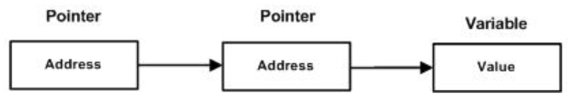
5.4 Pointer to Pointer
Pointer to a pointer is a form of multiple indirection, or a chain of pointers. Normally, a pointer contains the address of a variable. When we define a pointer to a pointer, the first pointer contains the address of the second pointer, which points to the location that contains the actual value:
A variable that is a pointer to a pointer must be declared by placing an additional asterisk in front of its name:
int **var;
When a target value is indirectly pointed to by a pointer to a pointer, accessing that value requires that the asterisk operator be applied twice.
Notes:
#include <stdio.h> int main () { int var; int *ptr; int **pptr; var = 3000; /* take the address of var */ ptr = &var; /* take the address of ptr using address of operator & */ pptr = &ptr; /* take the value using pptr */ printf("Value of var = %d\n", var ); printf("Value available at *ptr = %d\n", *ptr ); printf("Value available at **pptr= %d\n", **pptr); printf("Adress of ptr = %u\n", &ptr ); printf("Adress of ptr by pptr = %u\n", pptr); return 0;}

Slide 11
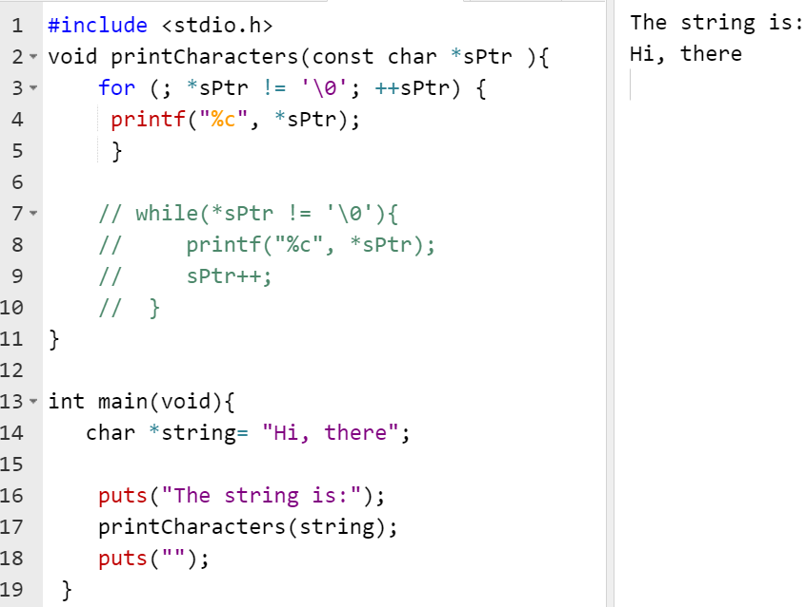
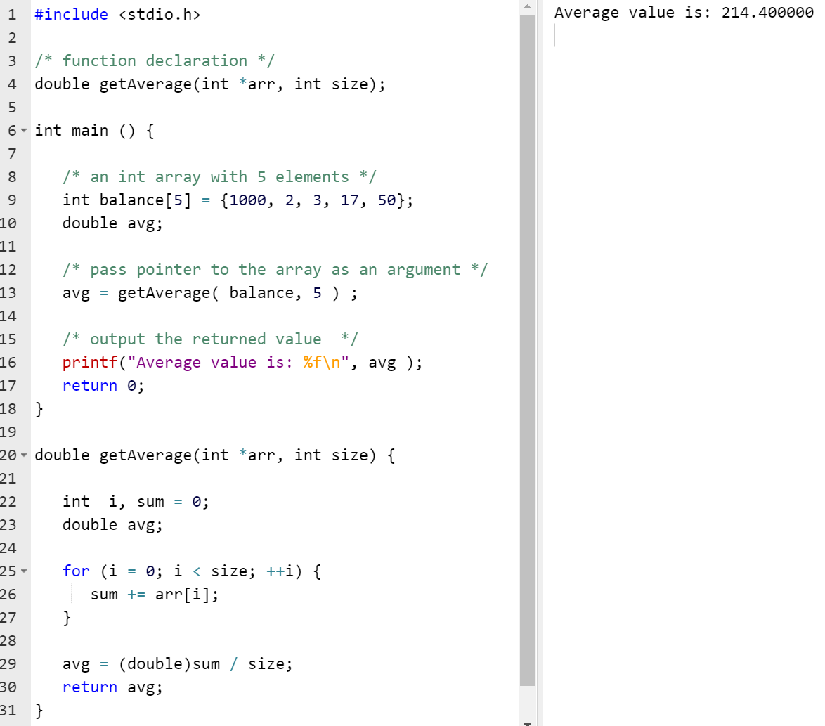
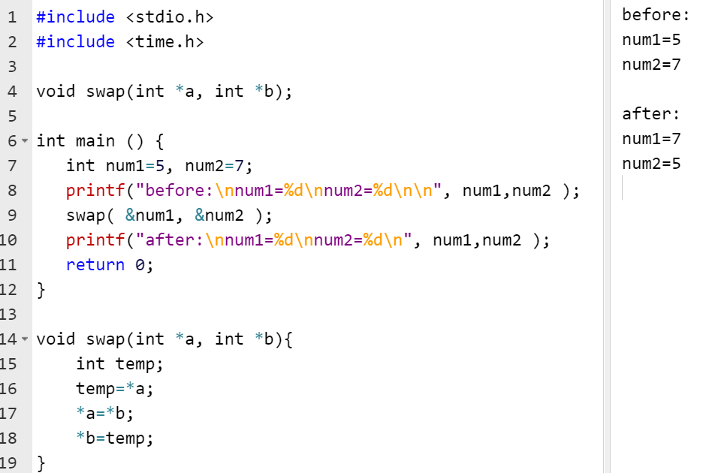
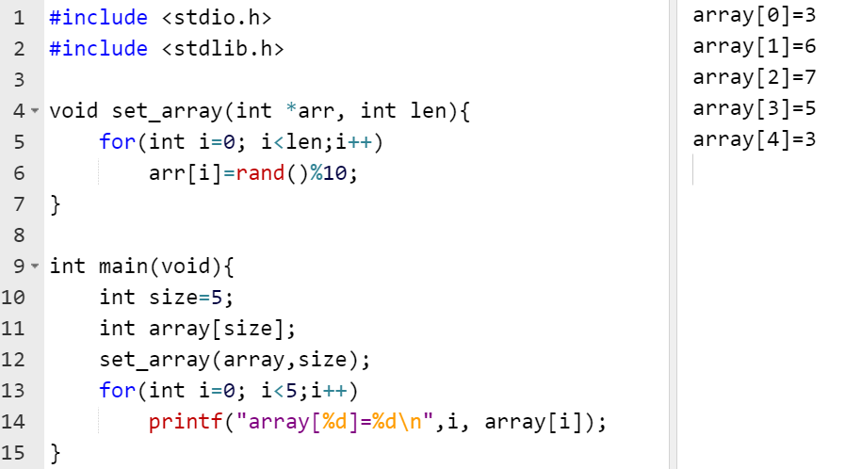
5.5 Passing pointers to functions
C programming allows passing a pointer to a function. To do so, simply declare the function parameter
The function, which can accept a pointer, can also accept an array as a pointer type.
Pass by Reference (example)
Notes:
#include <stdio.h> /* function declaration */double getAverage(int *arr, int size); int main () { /* an int array with 5 elements */ int balance[5] = {1000, 2, 3, 17, 50}; double avg; /* pass pointer to the array as an argument */ avg = getAverage( balance, 5 ) ; /* output the returned value */ printf("Average value is: %f\n", avg ); return 0;}double getAverage(int *arr, int size) { int i, sum = 0; double avg; for (i = 0; i < size; ++i) { sum += arr[i]; } avg = (double)sum / size; return avg;}
#include <stdio.h>#include <time.h> void swap(int *a, int *b);int main () { int num1=5, num2=7; printf("before:\nnum1=%d\nnum2=%d\n\n", num1,num2 ); swap( &num1, &num2 ); printf("after:\nnum1=%d\nnum2=%d\n", num1,num2 ); return 0;}void swap(int *a, int *b){ int temp; temp=*a; *a=*b; *b=temp;}
#include <stdio.h>
void printCharacters(const char *sPtr ){
for (; *sPtr != '\0'; ++sPtr) {
printf("%c", *sPtr);
}
// while(*sPtr != '\0'){
// printf("%c", *sPtr);
// sPtr++;
// }
}
int main(void)
{
char *string= "print characters of a string";
puts("The string is:");
printCharacters(string);
puts("");
}

Slide 12
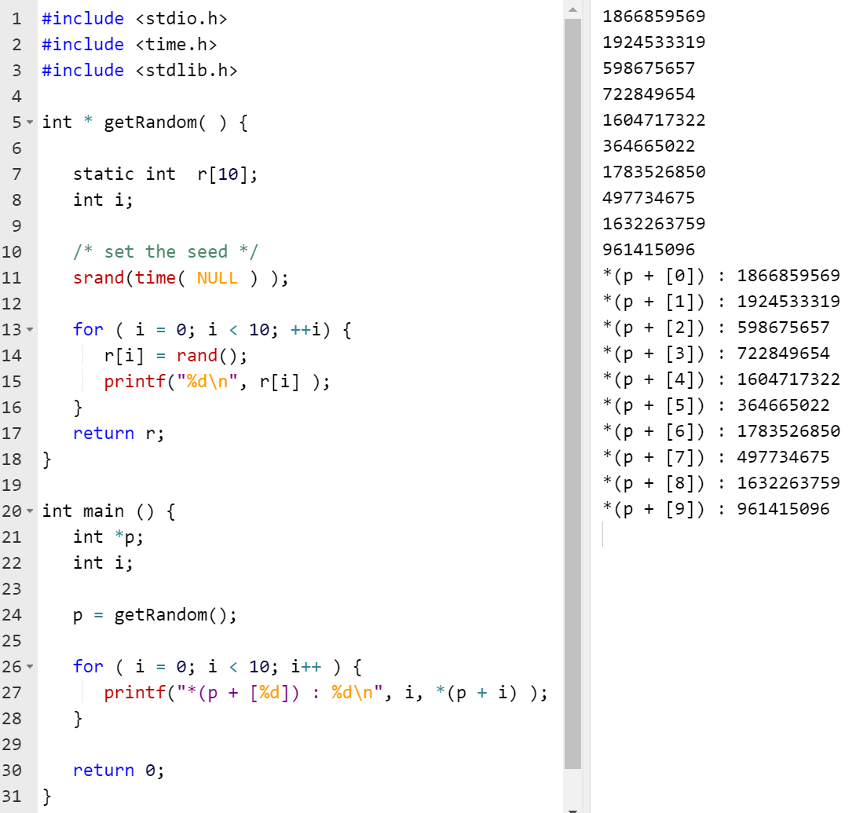
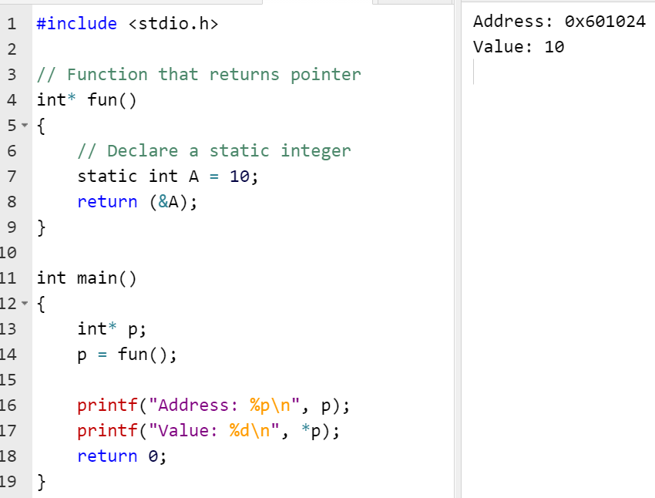
5.6 Pointer to functions
A pointer to a function contains the address of the function in memory. Pointers to functions can be passed to functions, returned from
functions, stored in arrays and assigned to other function pointers.
C also allows to return a pointer from a function.
int * myFunction() {
.
.
.
}
It is not a good idea to return the address of a local variable outside the function, so you would have to define the local variable as static variable.
Notes:
int * getRandom( ) {
static int r[10];
int i;
/* set the seed */
srand(time( NULL ) );
for ( i = 0; i < 10; ++i) {
r[i] = rand();
printf("%d\n", r[i] );
}
return r;
}
int main () {
int *p;
int i;
p = getRandom();
for ( i = 0; i < 10; i++ ) {
printf("*(p + [%d]) : %d\n", i, *(p + i) );
}
return 0;
}

Slide 13
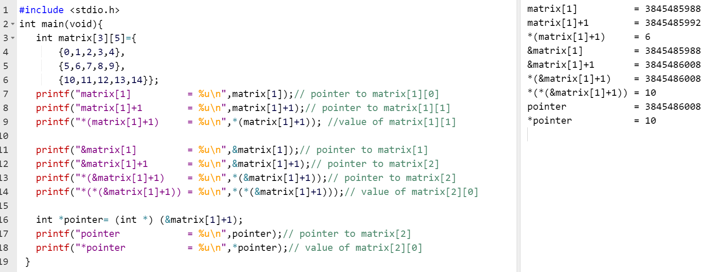
5.7 Multidimensional array pointer
Notes:
#include <stdio.h>
int main(void){
int matrix[3][5]={
{0,1,2,3,4},
{5,6,7,8,9},
{10,11,12,13,14}};
printf("matrix[1] = %u\n",matrix[1]);// pointer to matrix[1][0]
printf("matrix[1]+1 = %u\n",matrix[1]+1);// pointer to matrix[1][1]
printf("*(matrix[1]+1) = %u\n",*(matrix[1]+1)); //value of matrix[1][1]
printf("&matrix[1] = %u\n",&matrix[1]);// pointer to matrix[1]
printf("&matrix[1]+1 = %u\n",&matrix[1]+1);// pointer to matrix[2]
printf("*(&matrix[1]+1) = %u\n",*(&matrix[1]+1));// pointer to matrix[2]
printf("*(*(&matrix[1]+1)) = %u\n",*(*(&matrix[1]+1)));// value of matrix[2][0]
int *pointer= (int *) (&matrix[1]+1);
printf("pointer = %u\n",pointer);// pointer to matrix[2]
printf("*pointer = %u\n",*pointer);// value of matrix[2][0]
}

Slide 14

References
Each Reference is indicated on the footer on each slide.
Books:
The_C_Programming_Language_(2nd_Edition_Ritchie_Kernighan)
Learn to Program with C_ Learn to Program using the Popular C Programming Language (Noel Kalicharan)
C How to Program, 8th edition, Paul Deitel and Harvey Deitel, Pearson, 2016.

Slide 15


Thank You
Nazrin Dolkhanova Sultanli
Nazrin.Sultanli.Dolkhanova@bhos.edu.az
Baku Higher Oil School

